Slide 1
MVC
MVC Design Pattern・Multiple View Controllers
ITP4206

Slide 2
Topics Today
MVC Pattern
Multiple View Controller
Container View Controller
Multiple VC and Storyboard
Segue
Passing Data between ViewControllers

Slide 3
MVC Pattern
Model・View・View-Controller

Slide 4
Design Patterns
A general reusable solution to a commonly occurring problem (Wikipedia)
iOS recommended Design Pattern
MVC
M - Model
V - View
C - View Controller

Slide 5
Model-View-Controller
Common in Modern Development
Separates the three key features:
Maintaining Application State - Model
Rendering Information to the user - View
Handling User Input and Coordinate View and Model - View Controller

Slide 6
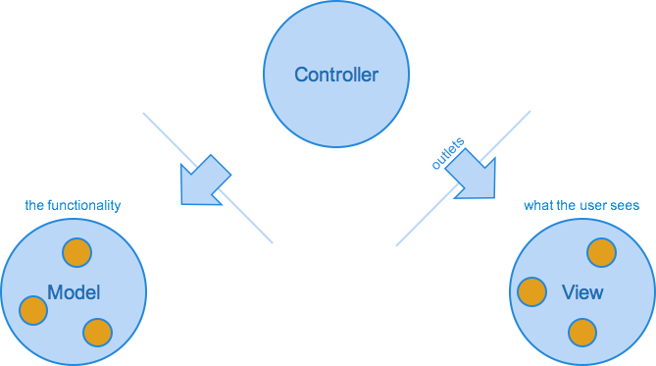
Model-View-Controller

Slide 7
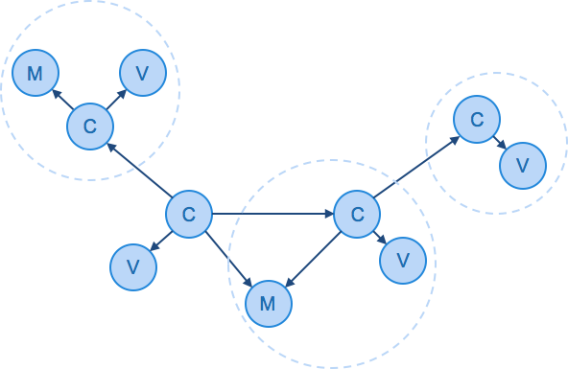
Multiple MVC

Slide 8
MVC Advantages & Disadvantages
Advantages
Modification of one logic does not effect other logic.
Easy to maintain and enhance the project.
Parallel development is possible.
Disadvantages
Everything is coordinate by VC may due to a very big ViewController class

Slide 9
Multiple View Controller
Container View Controller・Protocol and Delegate・Closure

Slide 10
Implementing Multiple VCs
The most common technique for working with view controllers is to place them inside a storyboard.
Allows you to directly establish relationships between the view controllers in your app without writing code.
See the flow of control—from controllers created when your app first launches, to controllers that are instantiated in response to a user’s actions.

Slide 11
Implementing Multiple VCs
Storyboard includes view controllers, associated views, and connection arrows that establish relationships between the view controllers. In effect, this storyboard tells a story, starting with one scene and later showing others in response to a user’s actions.

Slide 12
Implementing Multiple VCs
Storyboard represents a specific workflow through part of your UI, the initial view controller represents the first scene in that workflow.
Establish relationships from the initial view controller to other view controllers in the storyboard.

Slide 13
Type of relationship
The type of relationship you establish determines when a connected view controller is instantiated by iOS, as follows:
if the relationship is a segue, the destination view controller is instantiated when the segue is triggered
If the relationship represents containment, the child view controller is instantiated when its parent is instantiated.
If the controller is not the destination or child of another controller, it is never instantiated automatically. You must instantiate it from the storyboard programmatically.

Slide 14
Implementing Multiple VCs
To identify a specific view controller or segue inside a storyboard
use Interface Builder to assign it an identifier string that uniquely identifies it.
Essential for programmatically load a view controller from the storyboard.
When you build an app using storyboards, you can
use a single storyboard to hold all of its view controllers, or
create multiple storyboards and implement a portion of the user interface in each.
One storyboard in your app is almost always designated as the main storyboard.

Slide 15
Content VC for display content
A content view controller presents content on the screen using a view or a group of views organized into a view hierarchy. A content view controller knows about the subset of the app’s data that is relevant to the role the controller plays in the app.
Where we use content view controllers:
To show data to the user
To collect data from the user
To perform a specific task
To navigate between a set of available commands or options, such as on the launch screen for a game

Slide 16
Container VC for managing navigations
Container controller can be both a parent to other controllers and a child of another container.
Combination of controllers establishes a view controller hierarchy.

Slide 17
Container VC for managing navigations
Each type of container view controller establishes a user interface that its children operate in. The outlook is based on its type
container provides its own API to manage its child.
container decides whether the children have a relationship between them and what relationship is.
container manages a view hierarchy just as other VC do.
container might impose specific design consideration on its children.

Slide 18
Type of major container VC
Navigation Controller
Parent-child relationship (top-down level)
TabBarController
Sibling relationship (same level)

Slide 19
UINavigationController
A navigation controller presents data that is organized hierarchically by UINavigationController class.
a stack-based collection of content view controllers. This stack represents the path taken by the user through the hierarchical data,
the bottom of the stack reflecting the starting point
the top of the stack reflecting the user’s current position in the data.

Slide 20
UINavigationController

Slide 21
UINavigationController

Slide 22
UITabBarController
A tab bar controller is a container view controller that you use to divide your app into two or more distinct modes of operation.
A tab bar controller is an instance of the UITabBarController class.
The tab bar has multiple tabs, each represented by a child view controller.
Selecting a tab causes the tab bar controller to display the associated view controller’s view on the screen.

Slide 23
UITabBarController

Slide 24
UITabBarController

Slide 25
Mixed use of UINavigation Controller & UITabBarController
Build a more complex navigation by mixed use of UINavigationController & UITabBarController.
UITabBarController MUST BE the root view controller.

Slide 26
UITabBarController

Slide 27
Other container view controllers
Split View Controllers
Page Controllers
Popover Controllers , Modal View Controller (not a container view controllers, but a common practise for pop-up navigation)

Slide 28
Segue
Segue・Unwind Segue・Passing data between VCs

Slide 29
Segue
A segue represents a triggered transition that brings a new view controller into your app’s user interface, which contains a lot of information about the transition, including the following:
The object that caused the segue to be triggered, known as the sender
The source view controller that starts the segue
The destination view controller to be instantiated
The kind of transition that should be used to bring the destination view controller onscreen
An optional identifier string that identifies that specific segue in the storyboard

Slide 30
Segue
When a segue is triggered, iOS takes the following actions:
It instantiates the destination view controller using the attribute values you provided in the storyboard.
It gives the source view controller an opportunity to configure the new controller.
It performs the transition configured in the segue.

Slide 31
Trigger Segue Programmatically
A segue is usually triggered because an object associated with the source VC, such as a control or gesture recognizer, triggered the segue.
segue can also be triggered programmatically as long as the segue has an assigned identifier.

Slide 32
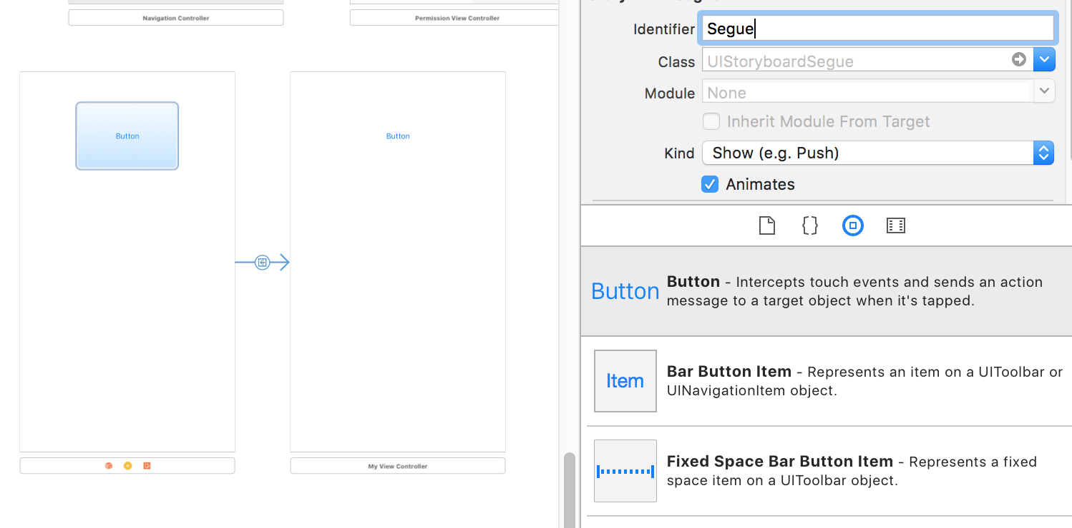
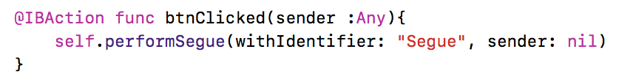
Trigger Segue Programmatically

Slide 33
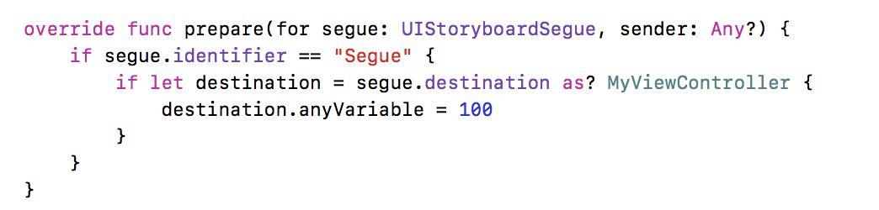
Passing Data to a Destination
Passing data by overriding the prepareForSegue: function:
Identify the segue with identifier
Retrieve the destination VC
Assign the value to the destination view controller.

Slide 34
Unwind segue
Segue will keep instantiate new VC, (duplicated object) which is not for go back to previous VC.
Use unwind segue go back to the previous VC.
To use exit segue:
Define @IBAction function in the former VC, which takes a UIStoryboard segue argument.
Connect the trigger point (button or table view cell and etc) to the exit outlet in latter VC.
Get back the data from the source destination.

Slide 35
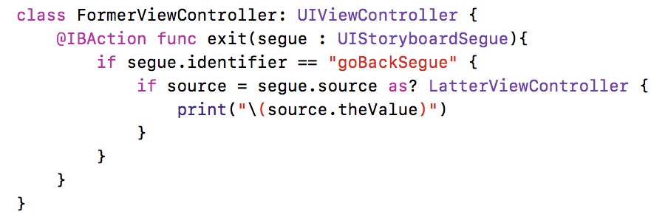
Example

Slide 36
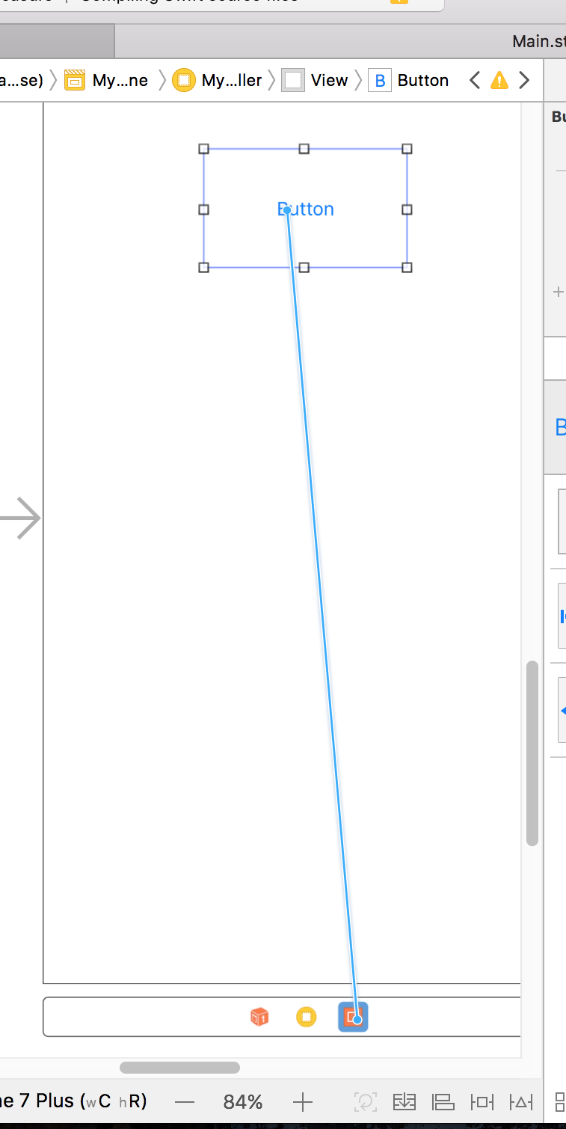
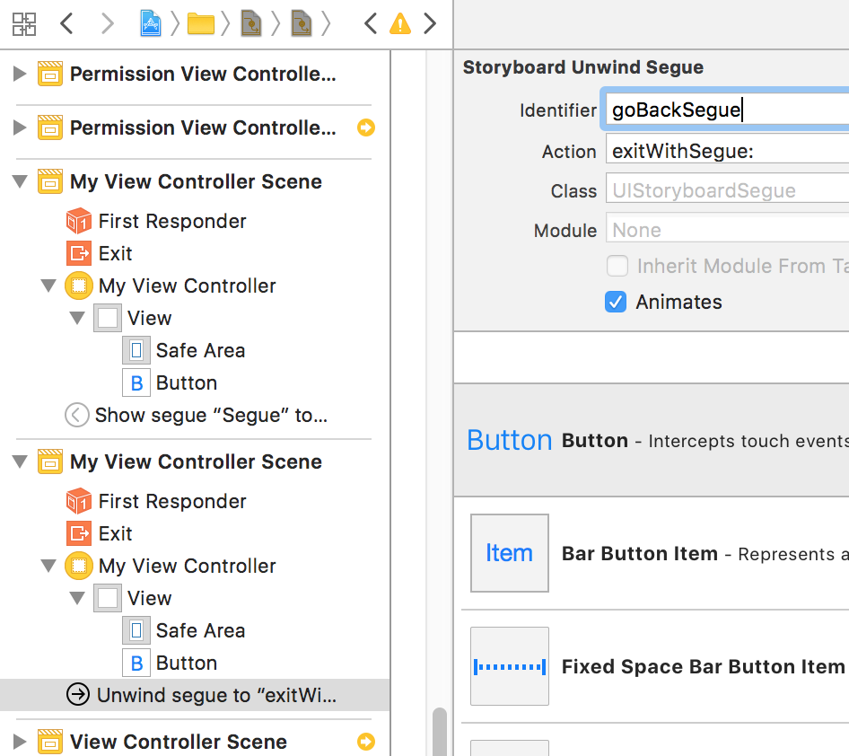
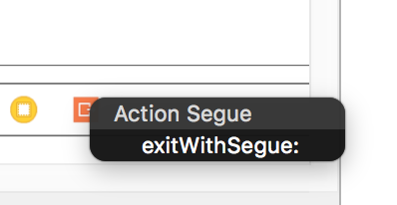
Example

Slide 37
Wrap up
MVC Pattern
Multiple View Controller
Container View Controller
Multiple VC and Storyboard
Segue
Passing Data between ViewControllers

